Slide 1
Microsoft Dynamics 365 Data entity
Overview and lessons learned
Peter Prokopecz

Slide 2
Introduction
Peter Prokopecz
AX technical lead @ JJ Food Service Ltd. (Food wholesale)
Owner @ DAXVision ERP Consulting Ltd. (Your external AX tech. team)
http://www.daxvisionerp.com/
info@daxvisionerp.com
Studies: IT engineer (2006) + MBA (2019)
Experience: AX from 2003

Slide 3
What will I talk about?
Data entity overview
Data management – Vendor invoice automation
Entity demo
OData
Composite data entity
Lessons learned

Slide 4

Data entity overview

Slide 5
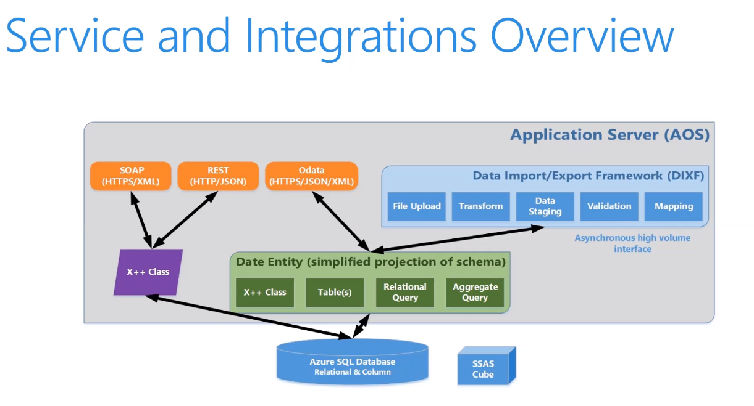
Services and integration
+ Azure Data Lake storage gen2!

Slide 6
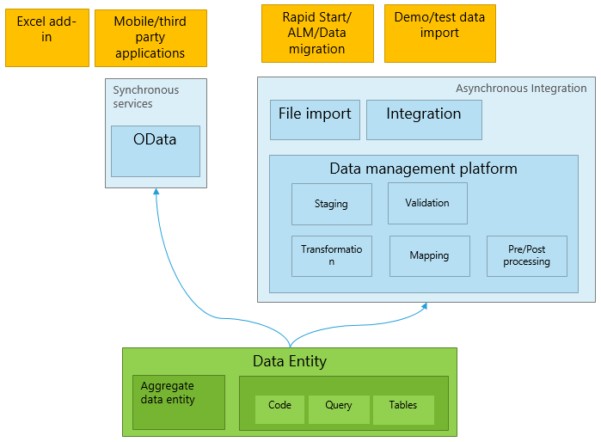
Data entity overview
DMF->DIXF->D365 Data Entity
http://daxvisionerp.com/call-ax-data-entity-from-postman/
http://daxvisionerp.com/excels-query-from-odata-feed-to-access-your-data-entity/
Notes:
2 min

Slide 7
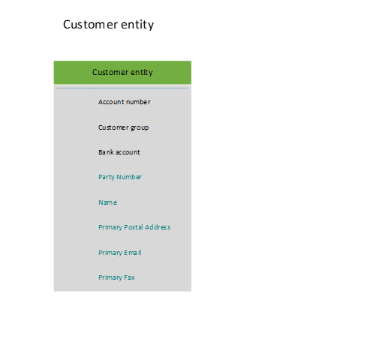
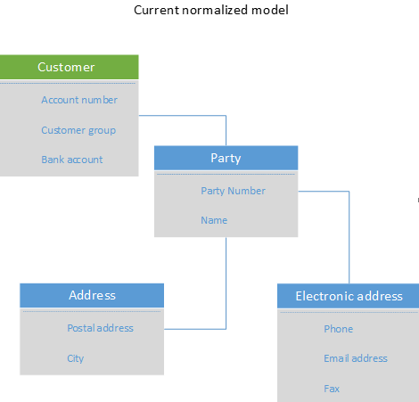
Data entity overview
Normalization – Redundancy/dependency
I NF-> II NF -> II NF structured process
Notes:
2 min

Slide 8
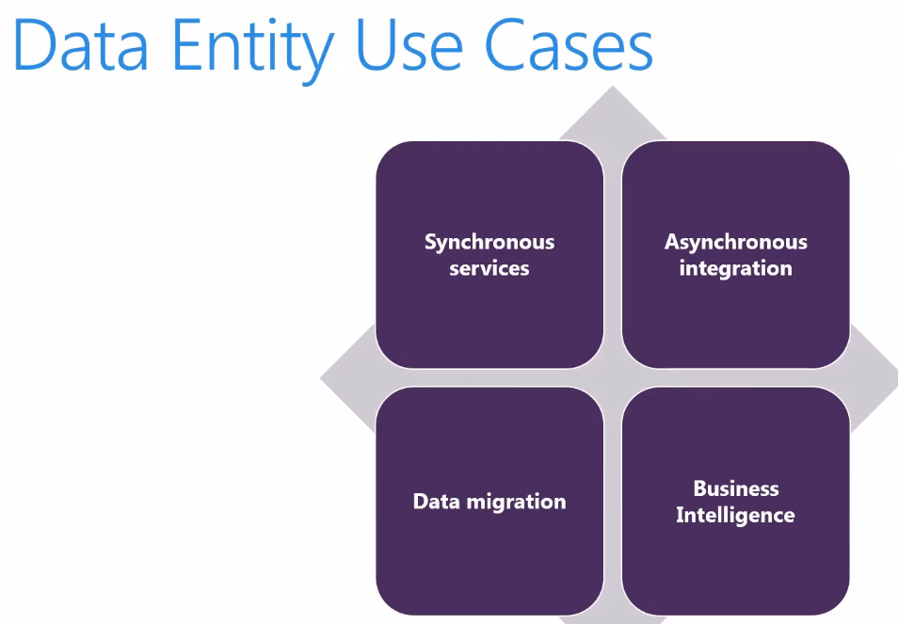
(Azure Data Lake!)

Slide 9
Data management

Slide 10
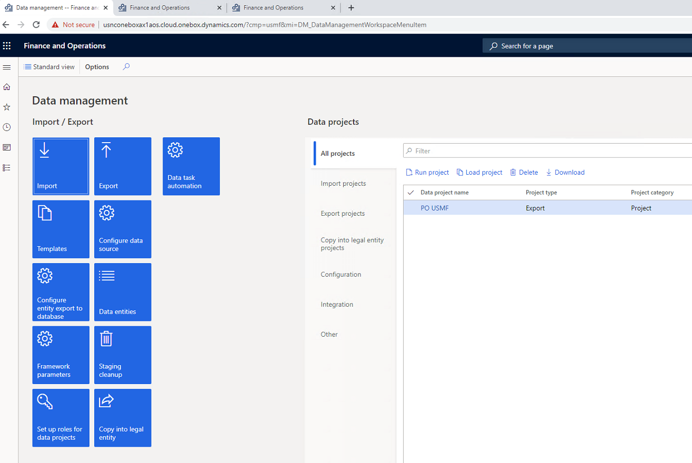
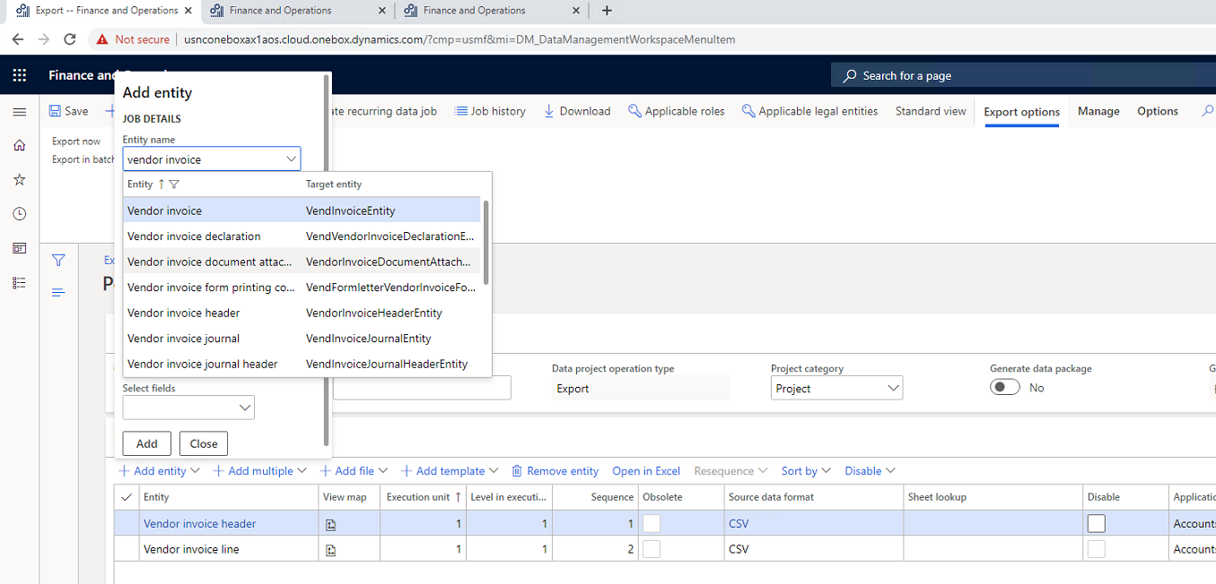
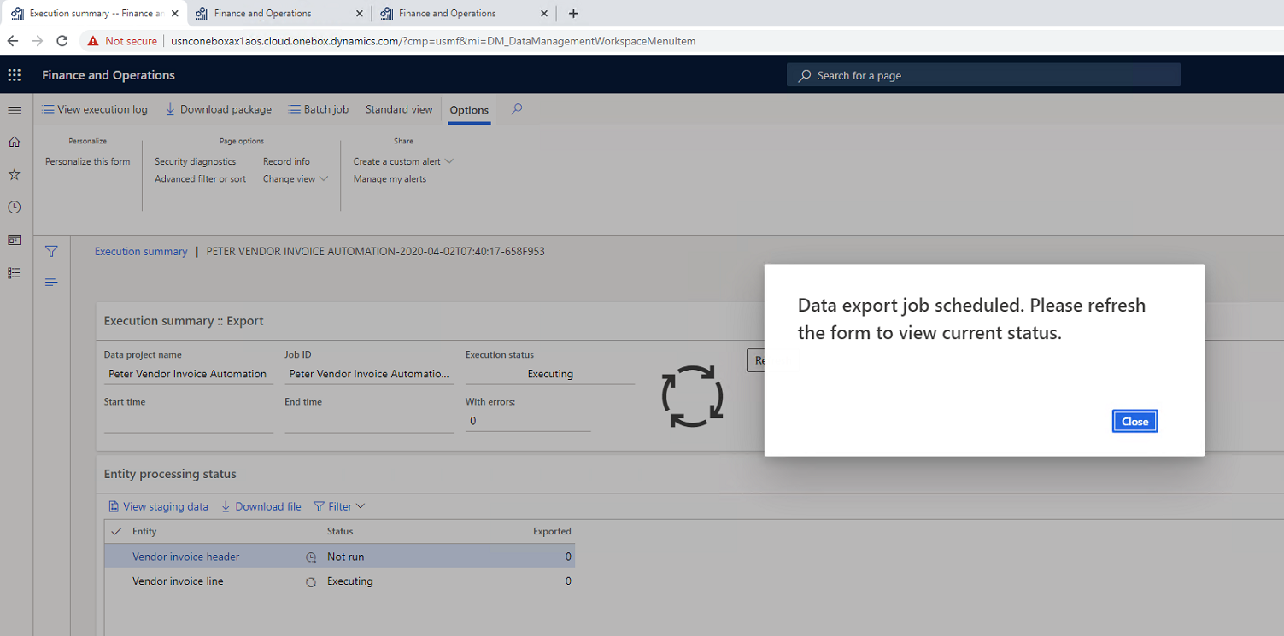
Data management UI

Slide 11
Vendor invoice automation
Accounts payables > Invoices > Pending vendor invoices
Vendor invoice header
Vendor invoice line
Vendor invoice document attachment
https://docs.microsoft.com/en-us/dynamics365/finance/accounts-payable/vendor-invoice-automation

Slide 12
Demo
Data management

Slide 13
Data entity development

Slide 14
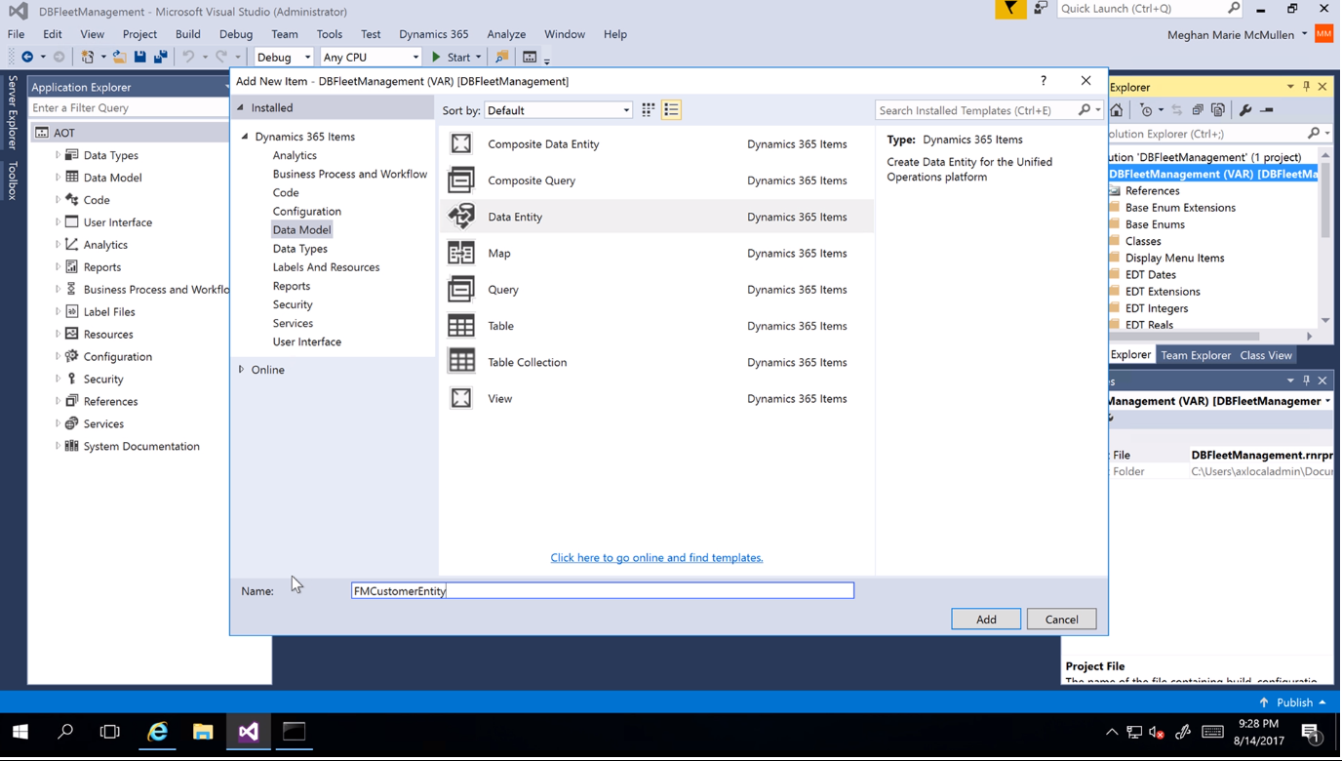
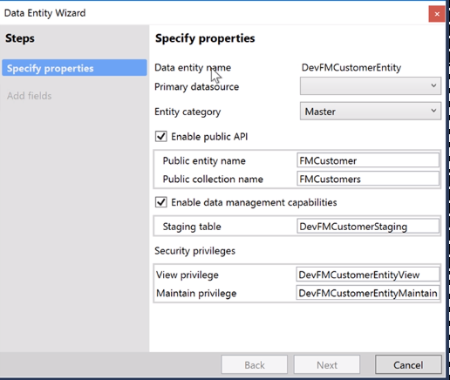
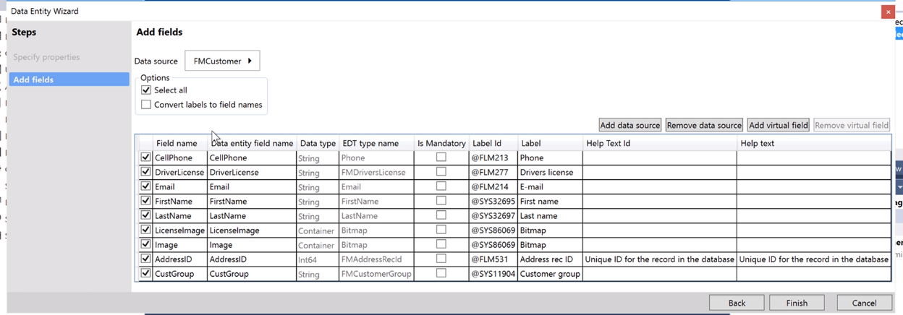
Creating Data entities

Slide 15
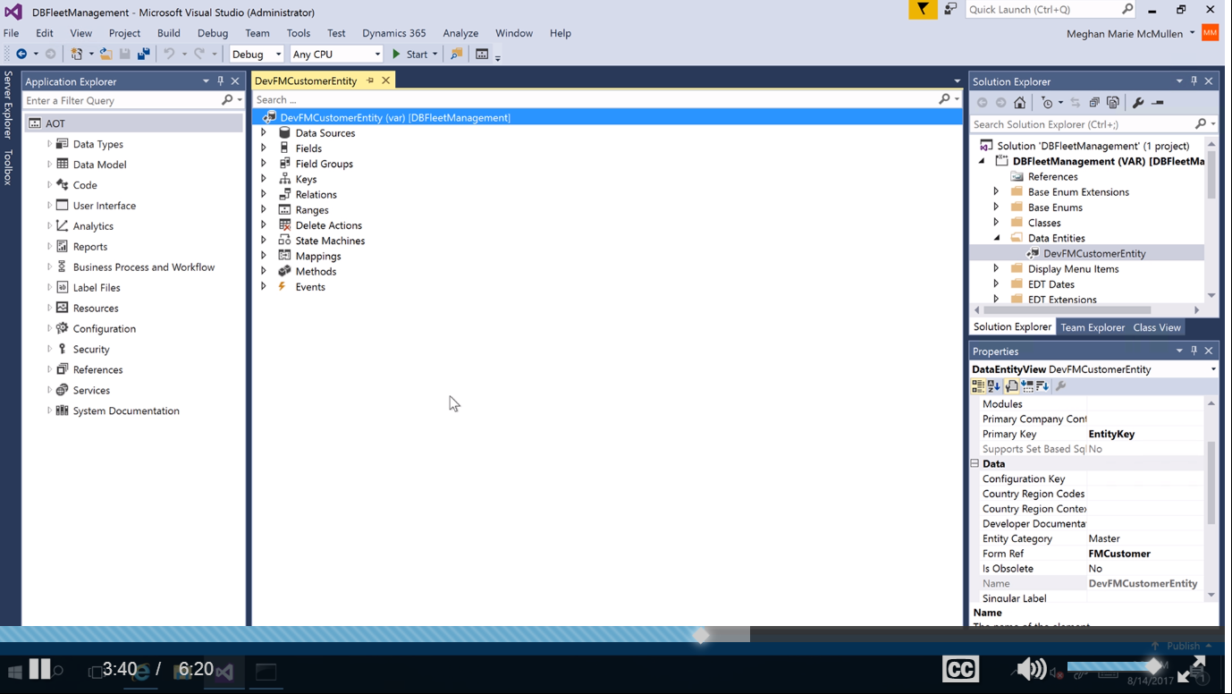
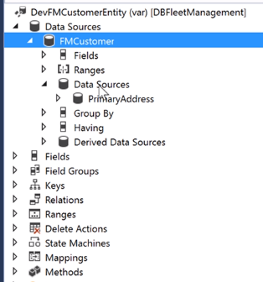
Data entity in AOT

Slide 16
DEV
Naming: <prefix><ConceptualName>Entity
Entity&view
Easiest test: runnable class, x++ select

Slide 17
Demo
Data entity development

Slide 18
Unmapped field types
Computed
T-SQL – new field added to the SQL View
Faster, more complicated to develope
http://daxvisionerp.com/view-computed-column-using-replace/
Virtual
X++ code (postLoad method) – similar to display methods on tables
Executed record by record
Computed column is better to use if possible because of better performance!
https://docs.microsoft.com/en-us/dynamics365/fin-ops-core/dev-itpro/data-entities/data-entity-computed-columns-virtual-fields

Slide 19
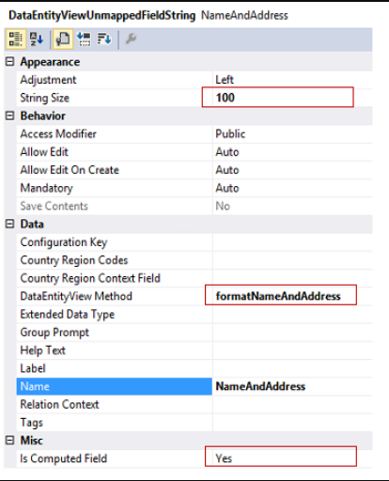
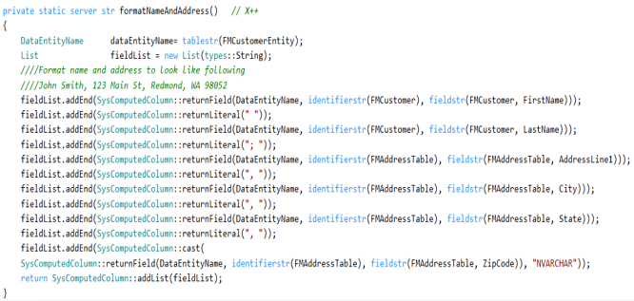
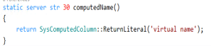
Computed

Slide 20
Demo
Computed column

Slide 21
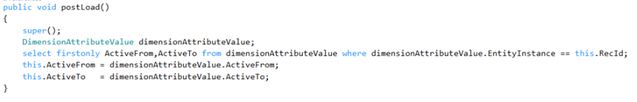
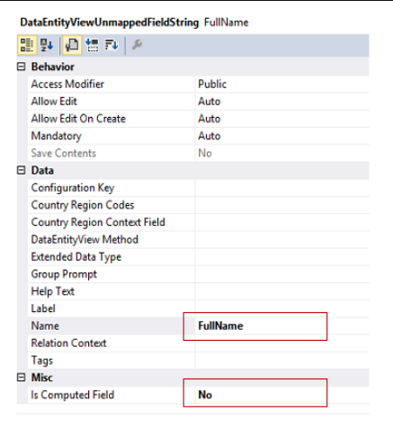
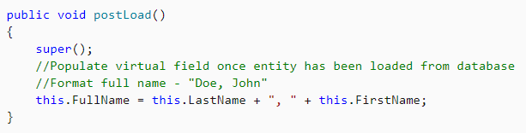
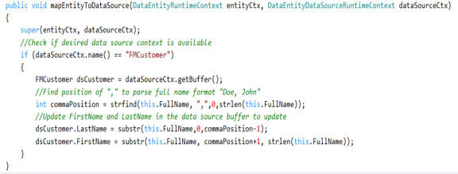
Virtual field

Slide 22
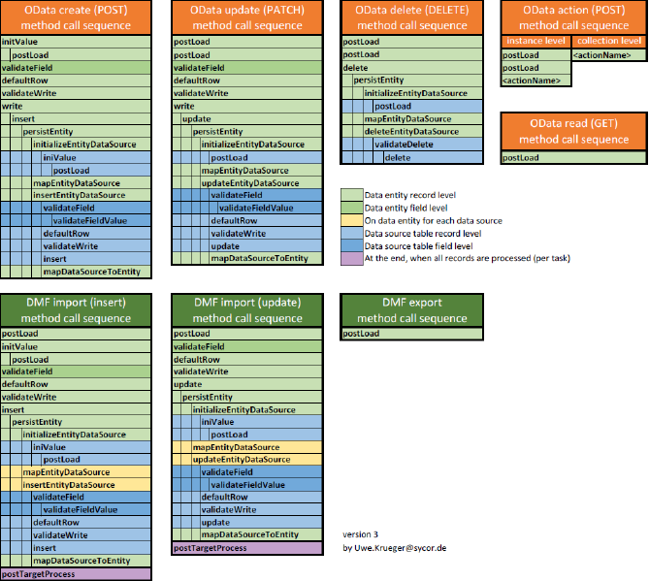
Method sequence

Slide 23
OData

Slide 24
Services and integration

Slide 25
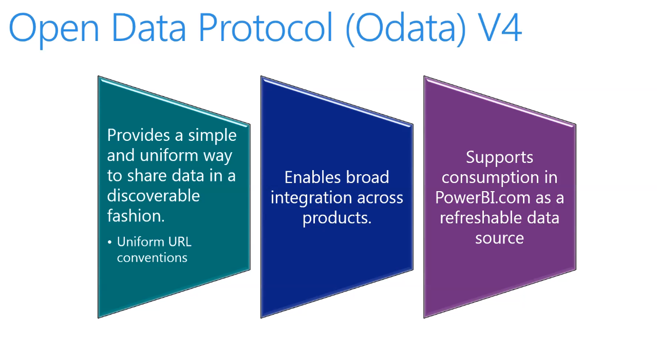
ODATA
Not for data integration

Slide 26
- $filter - $count - $orderby - $skip - $top - $expand - $select
ODATA – v4.0 query options

Slide 27
Odata query
URL | Description
[Your organization's root URL]/data/Customers | List all the customers.
[Your organization's root URL]/data/Customers?$top=3 | List the first three records.
[Your organization's root URL]/data/Customers?$select=FirstName,LastName | List all the customers, but show only the first name and last name properties.
[Your organization's root URL]/data/Customers?$format=json | List all the customers in a JSON format that can be used to interact with JavaScript clients.

Slide 28
Demo
OData browser and Excel

Slide 29
Test OData
http://daxvisionerp.com/call-ax-data-entity-from-postman/
http://daxvisionerp.com/excels-query-from-odata-feed-to-access-your-data-entity/
Notes:
2 min

Slide 30
Demo
OData Postman

Slide 31
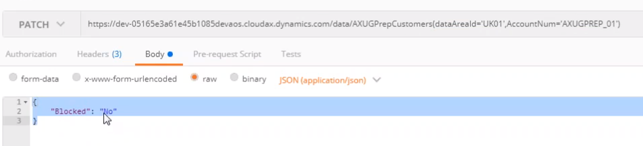
Update
Reference: AXUG Webinar, Cruz Margaix, How to develop your OData endpoints (Downloaded: 1.4.2020)

Slide 32
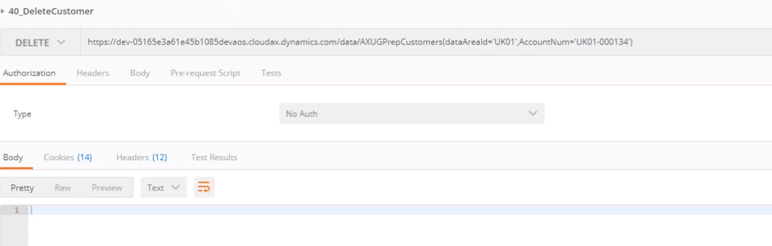
Delete
Reference: AXUG Webinar, Cruz Margaix, How to develop your OData endpoints (Downloaded: 1.4.2020)

Slide 33
Odata Enum
Enums namespace: Microsoft.Dynamics.DataEntities.
Enum syntax:
Microsoft.Dynamics.DataEntities.Gender'Unknown'
Microsoft.Dynamics.DataEntities.NoYes'Yes’
Enum usage example(‚eq’ and ‚ne’ can be used) :
https://environment.cloud.onebox.dynamics.com/data/CustomersV3?\$filter=PersonGender eq Microsoft.Dynamics.DataEntities.Gender'Unknown'
https://environment.cloud.onebox.dynamics.com/data/Currencies?\$filter=ReferenceCurrencyForTriangulation eq Microsoft.Dynamics.DataEntities.NoYes'No'

Slide 34
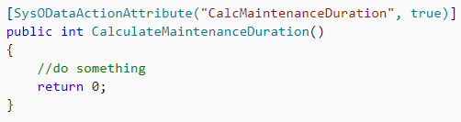
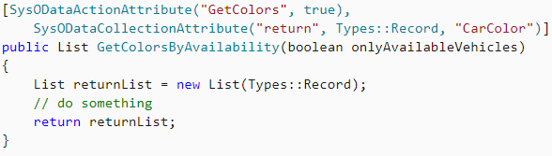
Odata Action
Adding business logic to Odata entity

Slide 35
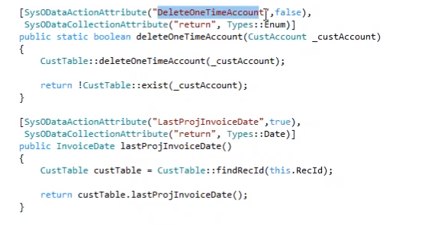
Odata action
Reference: AXUG Webinar, Cruz Margaix, How to develop your OData endpoints (Downloaded: 1.4.2020)

Slide 36
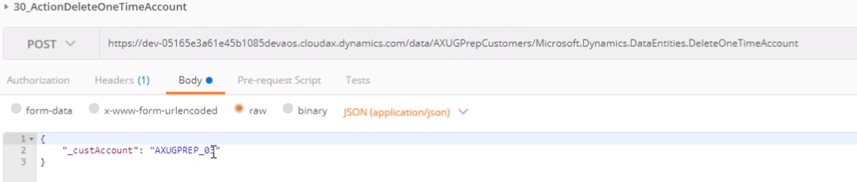
Odata action
Reference: AXUG Webinar, Cruz Margaix, How to develop your OData endpoints (Downloaded: 1.4.2020)

Slide 37
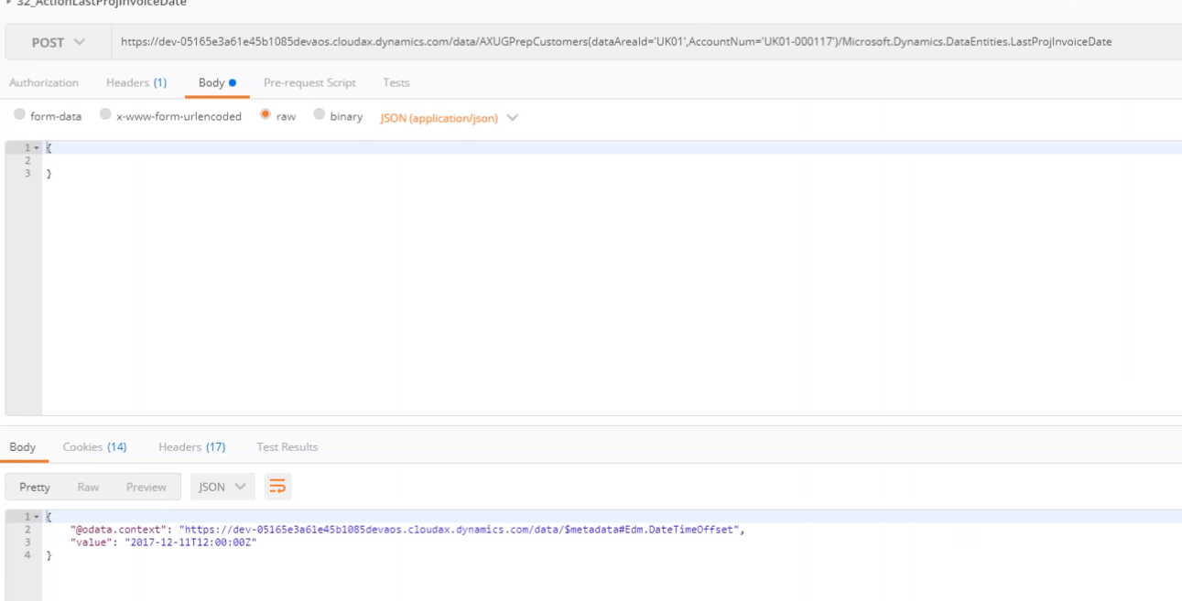
Odata action
Reference: AXUG Webinar, Cruz Margaix, How to develop your OData endpoints (Downloaded: 1.4.2020)

Slide 38
Composite data entity

Slide 39
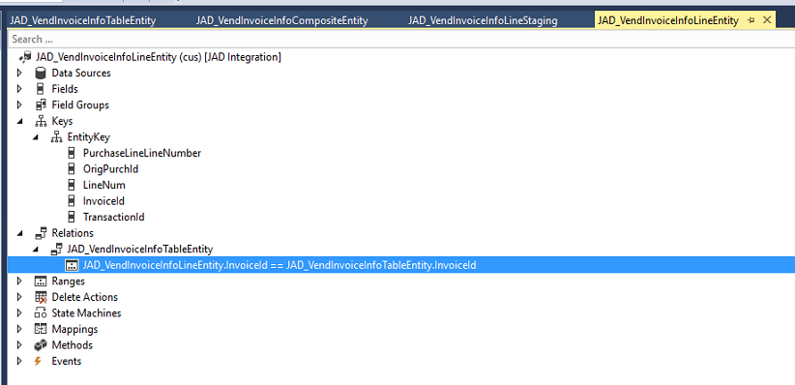
Line entity: add relation to header

Slide 40
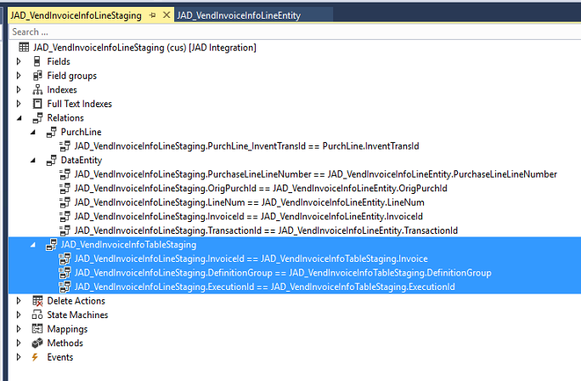
Line staging: add relation (include system added 2 fields)

Slide 41
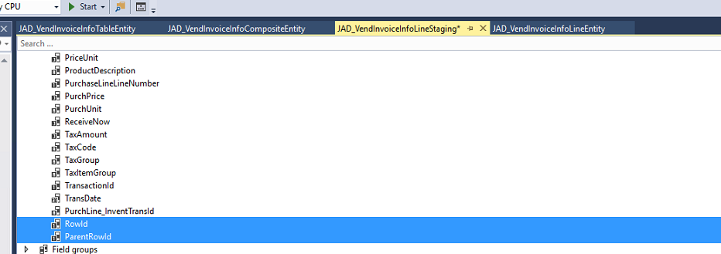
Line and Header staging: add rowId fields and index

Slide 42
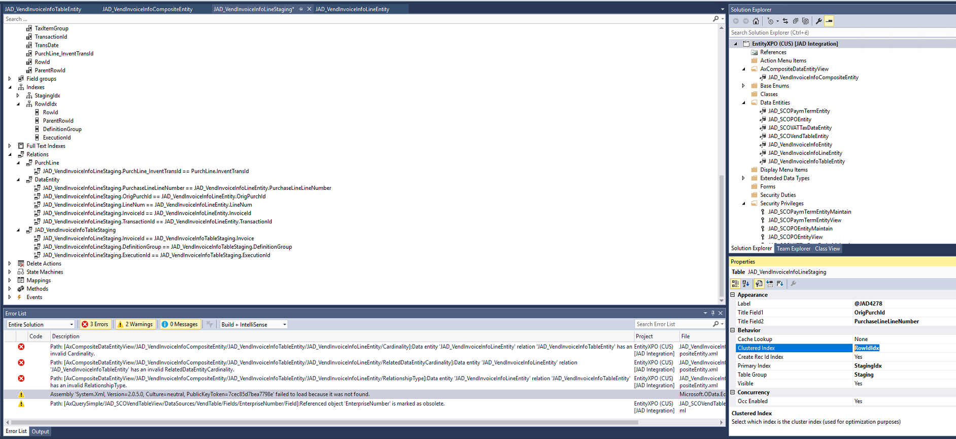
Line and Header staging: add rowId fields and index

Slide 43
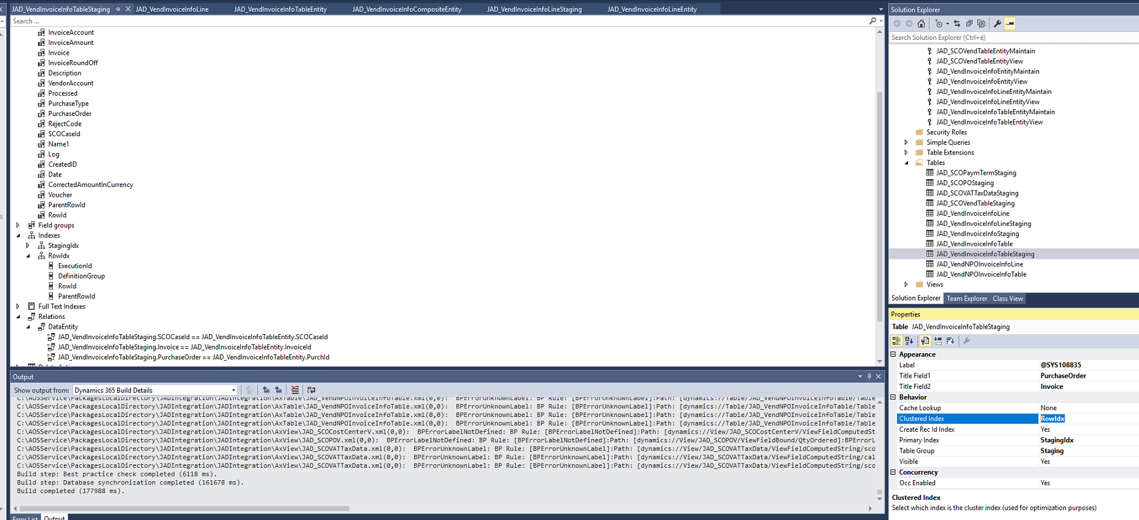
Line and Header staging: add rowId fields and index

Slide 44
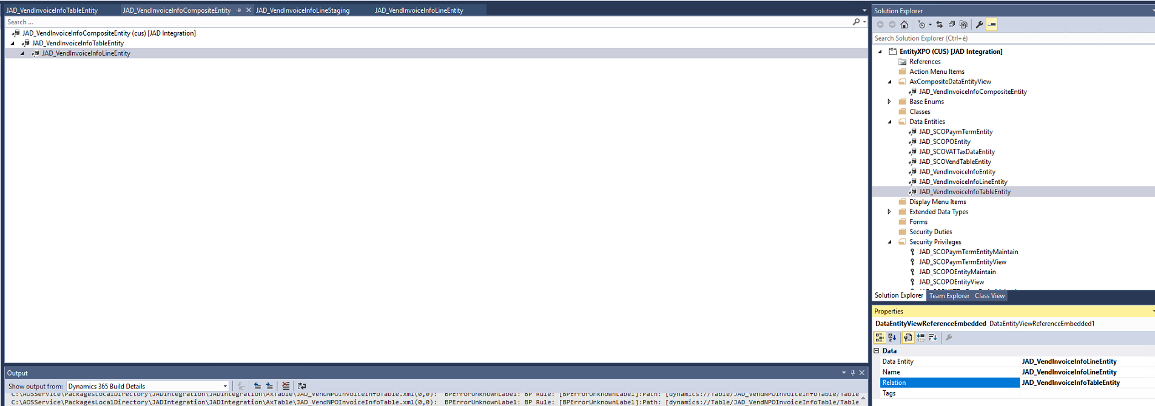
Create composite entity with relation

Slide 45
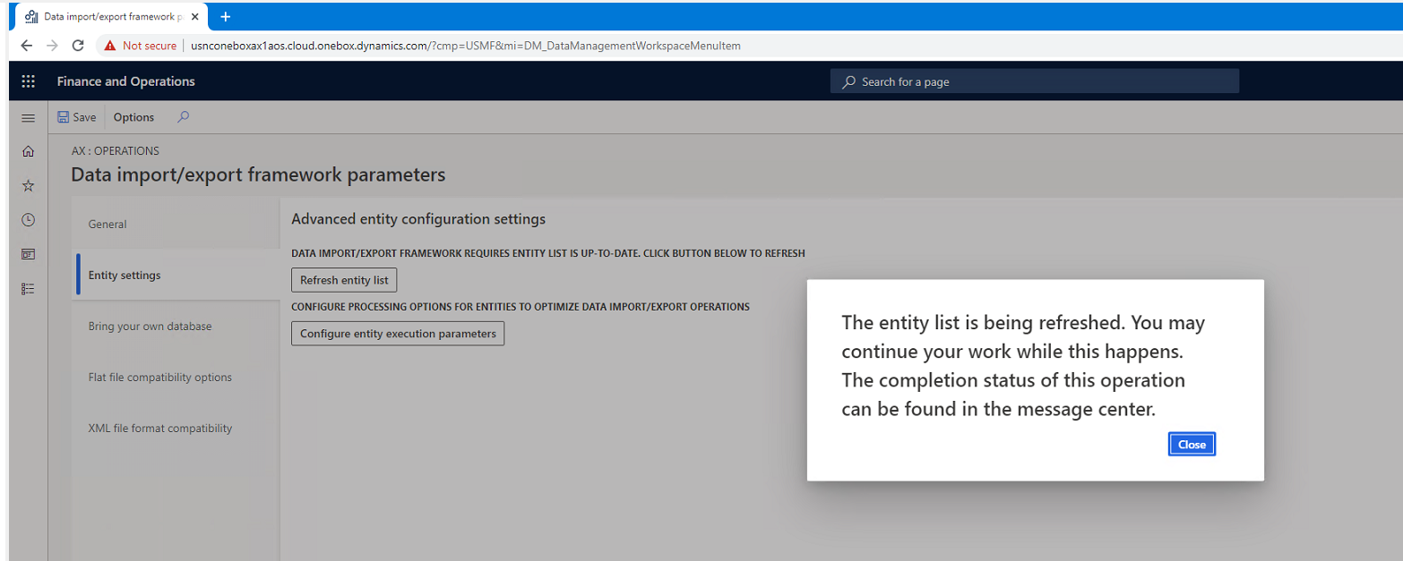
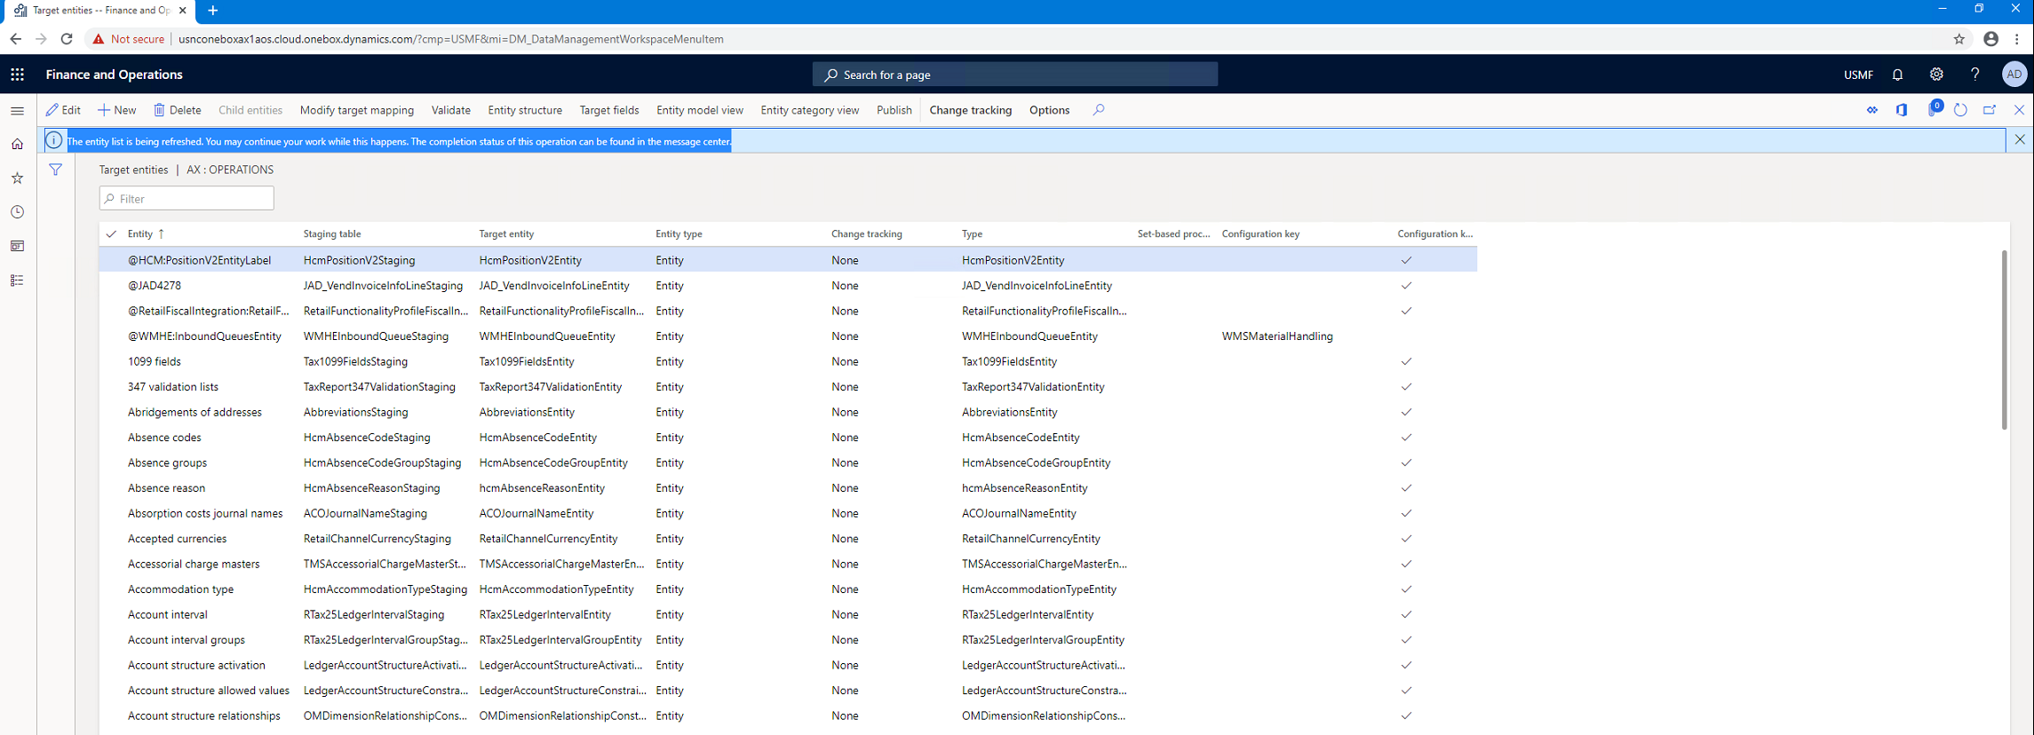
Refresh entity list

Slide 46
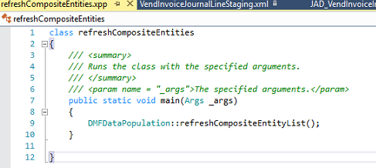
Alternative refresh
class refreshCompositeEntities
{
/// <summary>
/// Runs the class with the specified arguments.
/// </summary>
/// <param name = "_args">The specified arguments.</param>
public static void main(Args _args)
{
DMFDataPopulation::refreshCompositeEntityList();
}
}

Slide 47
Lessons learned

Slide 48
Lessons learned
„Given the large number of issues reported that end up being mitigated by cleaning up the execution history and staging table data and coupled with the fact that, the clean up jobs are not scheduled in most of the cases, we wanted to reach out and ask for your input on this topic.”
Microsoft is working on improvement of the cleanup jobs based on experience of early adopters.

Slide 49
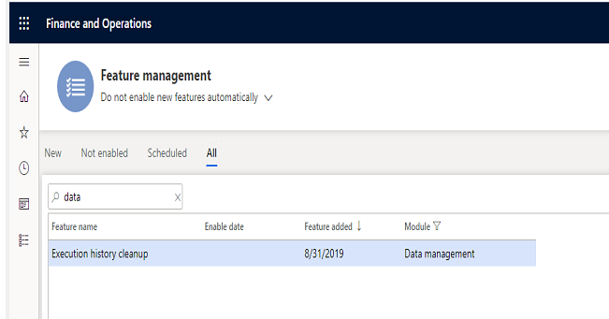
Lessons learned – data cleanup
Job history clean up (from Platform update 29)
The job history clean-up functionality in data management must be used to schedule a periodic cleanup of the execution history. This functionality replaces the previous staging table clean-up functionality, which is now deprecated. The following tables will be cleaned up by the clean-up process.
All staging tables
DMFSTAGINGVALIDATIONLOG
DMFSTAGINGEXECUTIONERRORS
DMFSTAGINGLOGDETAIL
DMFSTAGINGLOG
DMFDEFINITIONGROUPEXECUTIONHISTORY
DMFEXECUTION
DMFDEFINITIONGROUPEXECUTION
The functionality must be enabled in feature management and then can be accessed from Data management > Job history cleanup.
Notes:
2 min

Slide 50
Lessons learned
http://daxvisionerp.com/data-entity-export-error-azure-storage-emulator-issue/
http://daxvisionerp.com/data-entity-errors/
Notexists join not accepted in data entity datasourceban
Composite entity can only do full push
Data entity not shown in Data entities list – label issue
Notes:
2 min

Slide 51
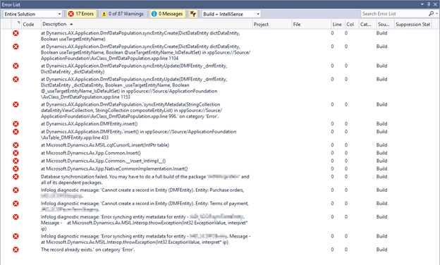
Lessons learned – build project
„Cannot create a record in Entity (DMFEntity)”

Slide 52
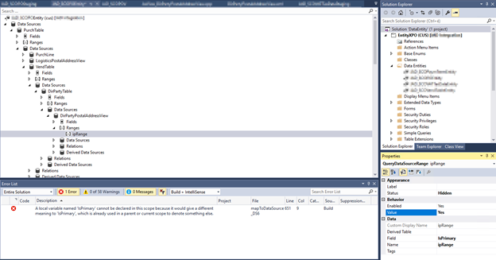
Lessons learned - IsPrimary
„Local variable named ‚isPrimary’ cannot be declared in this scope because it would give a different meaning to ‚IsPrimary’, which is already used in parent or current scope to define something else.”

Slide 53
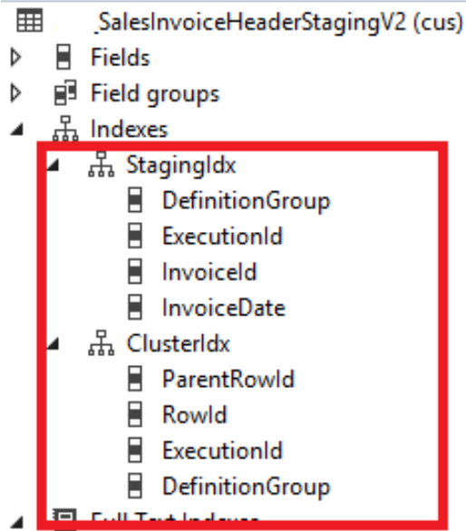
„The record already exisits” error when exporting composite
cluster & staging index?

Slide 54
What have I talked about
Data entity overview
Entity demo
Data management
OData
Composite data entity
Lessons learned

Slide 55
Thank you
Peter Prokopecz
info@daxvisionerp.com
DAXVision ERP Consulting Kft.
http://www.daxvisionerp.com/

